Slide 1



Iot presentation

Slide 2
Present By
Sourabh & Chirag Team

Slide 3
What is Iot ?

Slide 4
What is Iot ?
The Internet of Things is the network of physical object with unique identifiers that are connected with each other and are embedded with electronics, software and sensors which enables these objects to collect and exchange data.

Slide 5
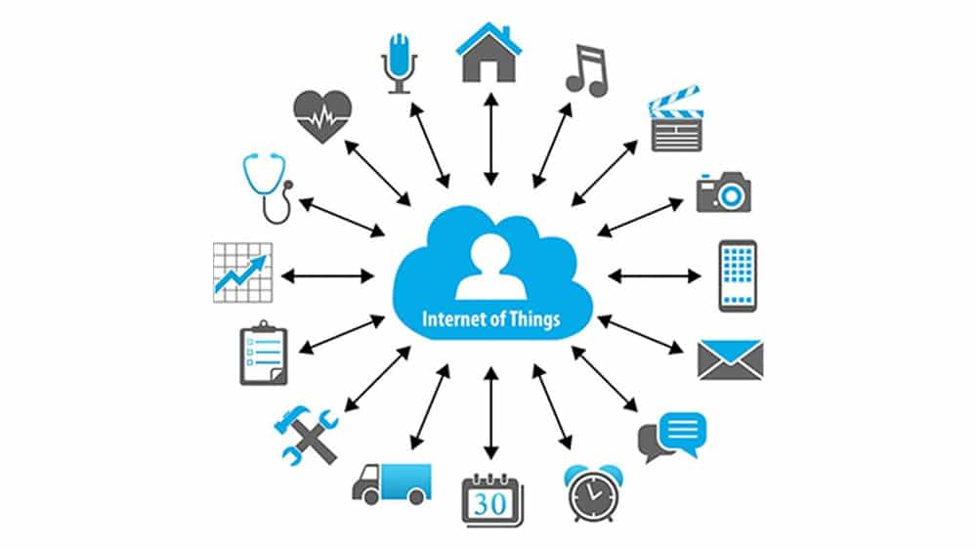

Slide 6
Revolution brought by iot.

Slide 7
Revolution brought by iot.
Healthcare
Manufacturing
Transportation
Analytics and cloud computing
Smart Home

Slide 8
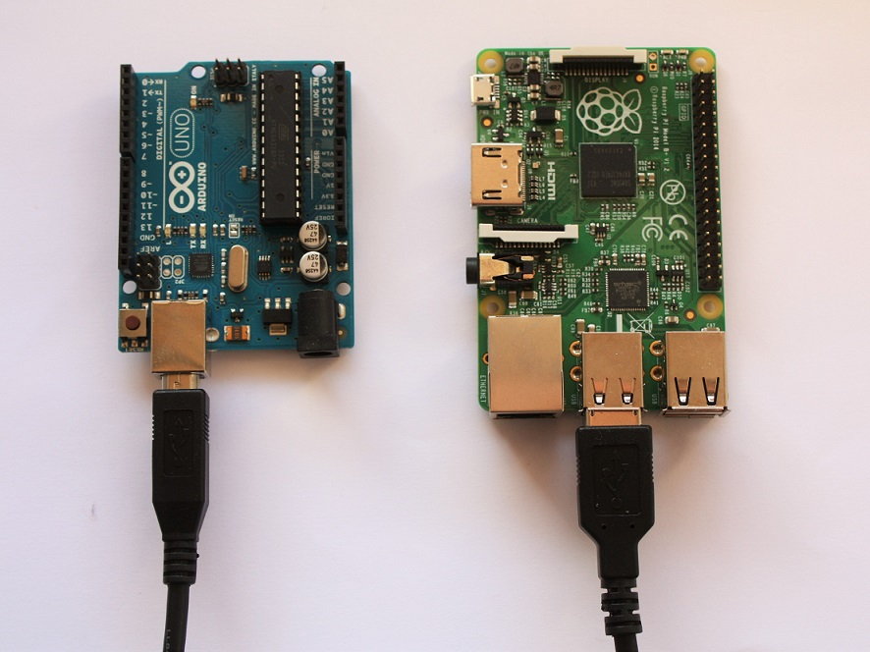
Iot technology
Two of the prime microcontroller and microprocessor used in IoT industry are:
Arduino
Raspberry Pie

Slide 9
Introduction to Arduino
Arduino is an open-source electronics platform based on easy-to-use hardware and software. Arduino boards are able to read inputs - light on a sensor, a finger on a button, or a Twitter message - and turn it into an output - activating a motor, turning on an LED, publishing something online.

Slide 10
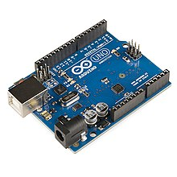

Slide 11
Introduction to Raspberry pie
Raspberry Pi is a small single board computer. By connecting peripherals like Keyboard, mouse, display to the Raspberry Pi, it will act as a mini personal computer.
Raspberry Pi is popularly used for real time Image/Video Processing, IoT based applications and Robotics applications.
Raspberry Pi is slower than laptop or desktop but is still a computer which can provide all the expected features or abilities, at a low power consumption.

Slide 12
Introduction to Raspberry pie con…
Raspberry Pi is more than computer as it provides access to the on-chip hardware i.e. GPIOs for developing an application. By accessing GPIO, we can connect devices like LED, motors, sensors, etc and can control them too.
There are different versions of raspberry pi available as listed below:
Raspberry Pi 1 Model A
Raspberry Pi 1 Model A+
Raspberry Pi 1 Model B
Raspberry Pi 1 Model B+

Slide 13
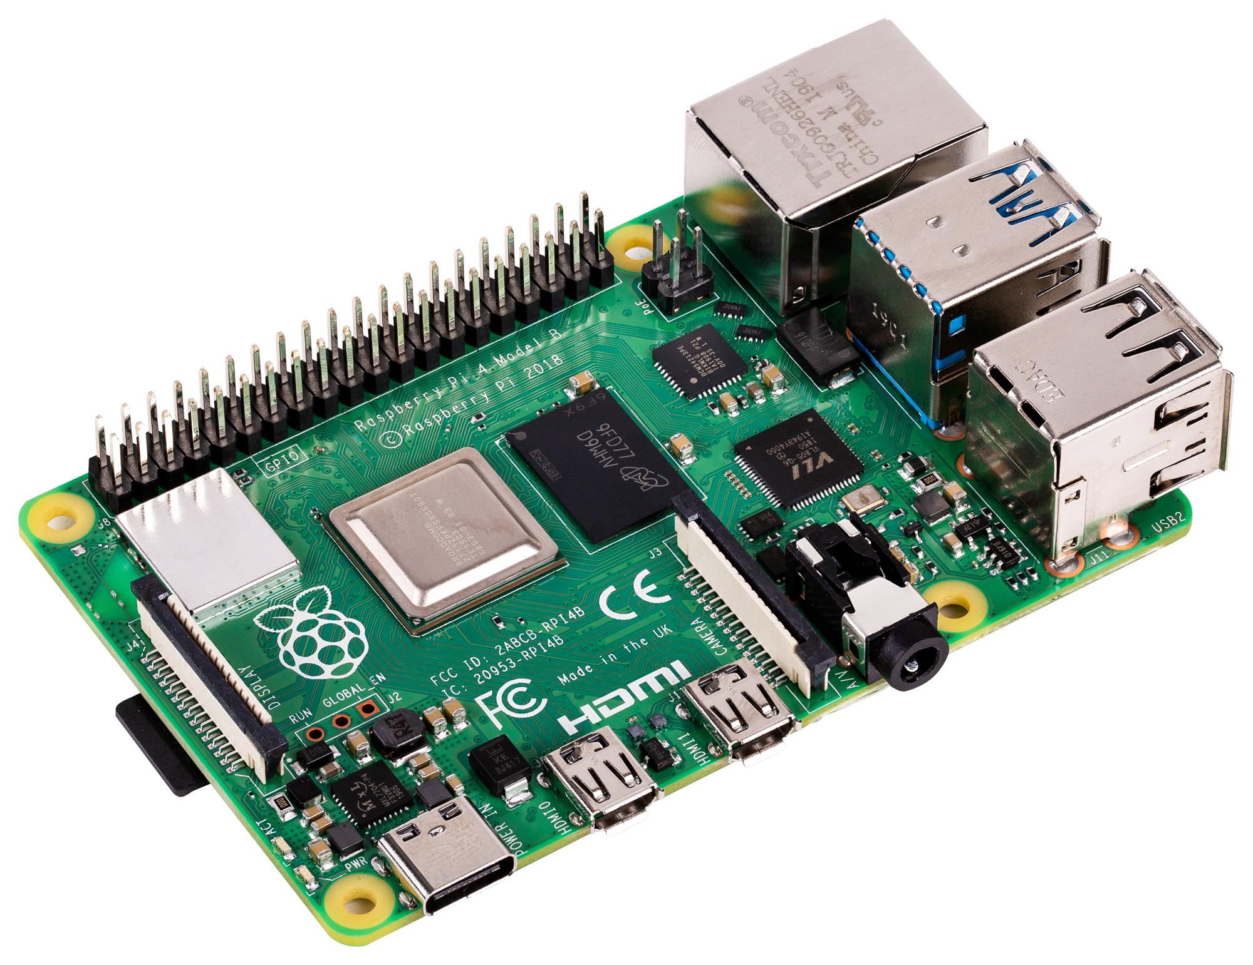

Slide 14
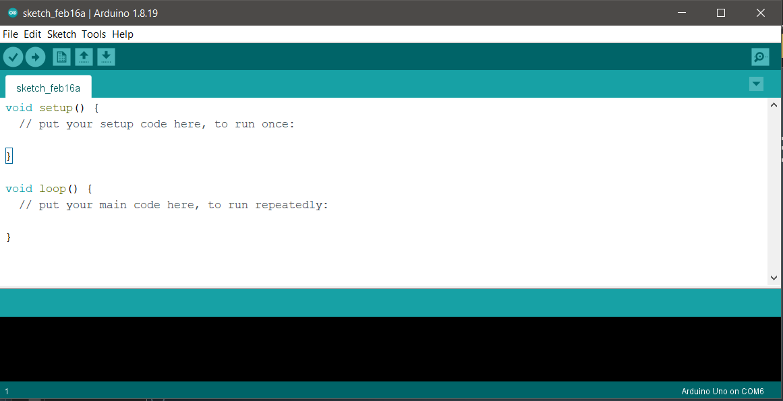
Introduction to arduino ide

Slide 15
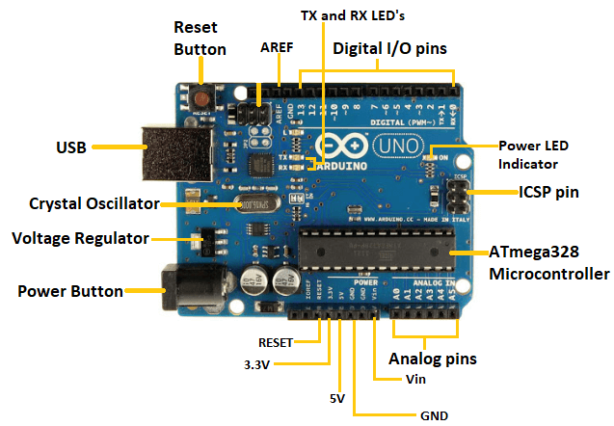
Arduino structure

Slide 16

Programming standard in arduino
Arduino is programmed with a C/C++ ‘Dialect’. Most C/C++ will work but much of the standard libraries will not work.

Slide 17
arduino programming language
Functions
variables
structure
For controlling the arduino board and performing computations.
Digital I/O
Analog I/O
Advance I/O
Time, Math, Trigonometry etc…..
Arduino data types and constants. Include the following elements:
Constants
Conversion
Data Type
Variable Scope
The elements of Arduino (C++) code.
Sketch
Control Structure
Operators

Slide 18
Functions
Digital I/O
Analog I/O
Time
digitalRead()
digitalWrite()
PinMode()
analogRead()
analogWrite()
analogReference()
delay()
delayMicroseconds()
Micros()
Millis()

Slide 19
Variables
Constant
conversion
Data Type
HIGH | LOW
INPUT | OUTPUT | INPUT_PULLUP
True | false
Floating and Integer constant
Byte()
Char()
Float()
Int()
Long()
Word()
Array
Bool
Byte
Char
Double, float, int, long
void

Slide 20
Structure
Sketch
Control
Operator
Loop()
Setup()
Break
Continue
Conditional
Loops
Switch
Arithmetic
Comparison
Boolean
Pointer Access
Compound

Slide 21
LED pin no. 13
void setup()
{
pinMode(13,OUTPUT);
}
void loop()
{
digitalWrite(13,HIGH);
delay(250);
digitalWrite(13,LOW);
delay(250);
}

Slide 22
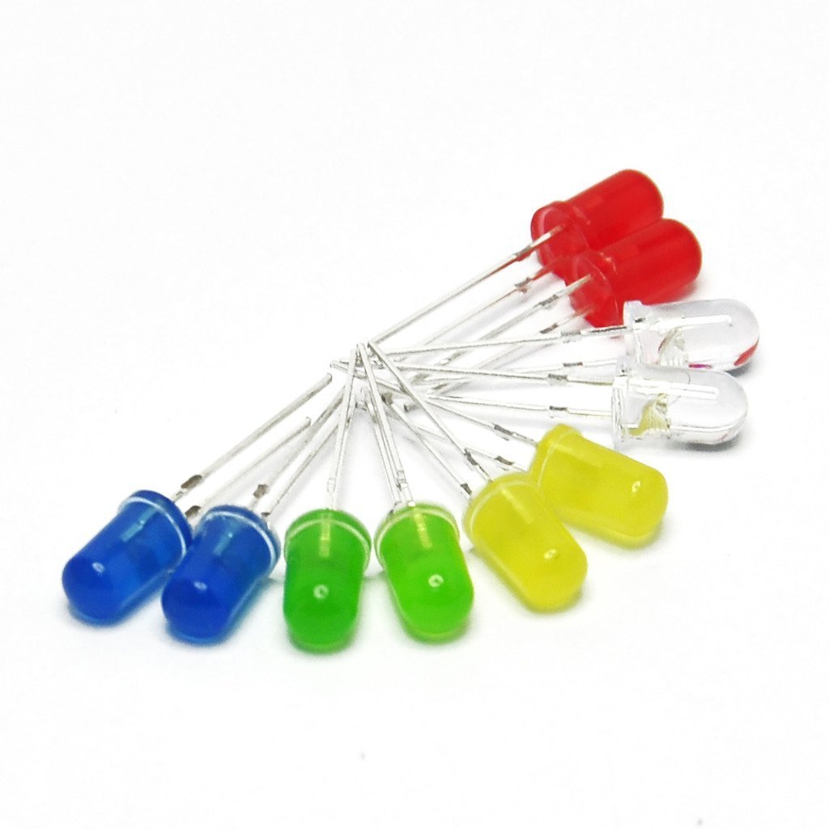
LED Lights with arduino
LED stands for light emitting diode. LED lighting products produce light up to 90% more efficiently than incandescent light bulbs.
The light-emitting diode (LED) is today's most energy-efficient and rapidly-developing lighting technology.

Slide 23
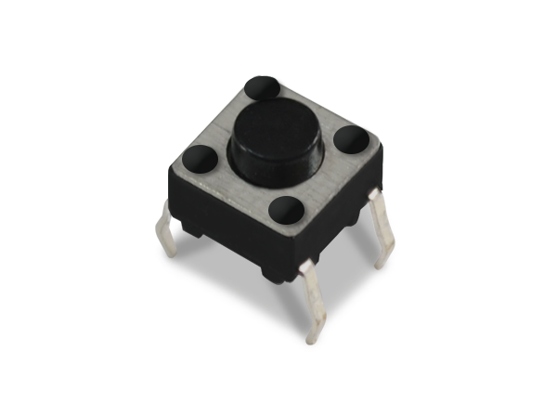
Switch input arduino
The button is also called pushbutton, tactile button or momentary switch. It is a basic component and widely used in many Arduino projects.

Slide 24
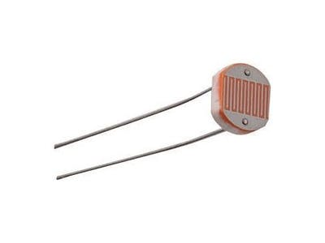
Photoresistor
A photoresistor is a passive component that decreases resistance with respect to receiving luminosity (light) on the component's sensitive surface.
There are three types of photoresistor: ultraviolet photoresistors, infrared photoresistors, visible light photoresistors.

Slide 25
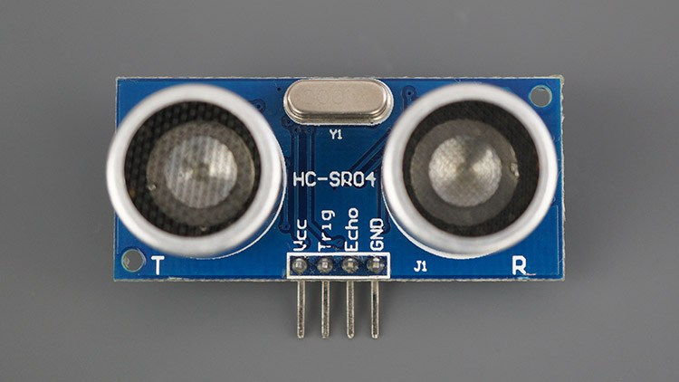
Ultrasonic
An ultrasonic sensor is an instrument that measures the distance to an object using ultrasonic sound waves. An ultrasonic sensor uses a transducer to send and receive ultrasonic pulses that relay back information about an object's proximity.

Slide 26
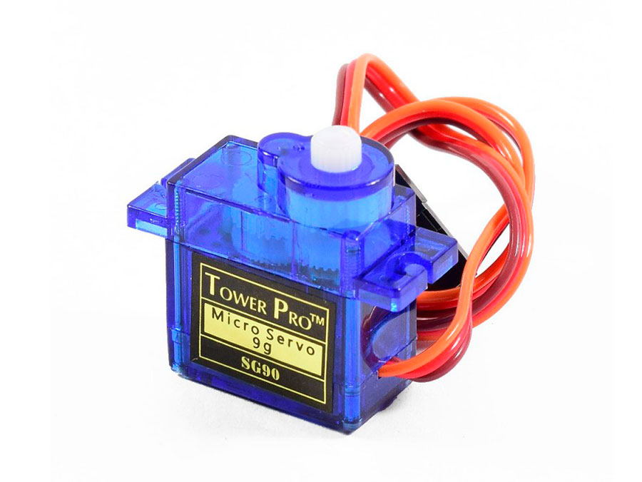
Servo motor
A servomotor (or servo motor) is a rotary actuator or linear actuator that allows for precise control of angular or linear position, velocity and acceleration. It consists of a suitable motor coupled to a sensor for position feedback.

Slide 27
Stepper motor
Stepper motors, due to their unique design, can be controlled to a high degree of accuracy without any feedback mechanisms.
The shaft of a stepper, mounted with a series of magnets, is controlled by a series of electromagnetic coils that are charged positively and negatively in a specific sequence, precisely moving it forward or backward in small "steps".
There are two types of steppers, Unipolars and Bipolars.
The stepper is controlled by with digital pins 8, 9, 10, and 11 for either unipolar or bipolar motors.

Slide 28
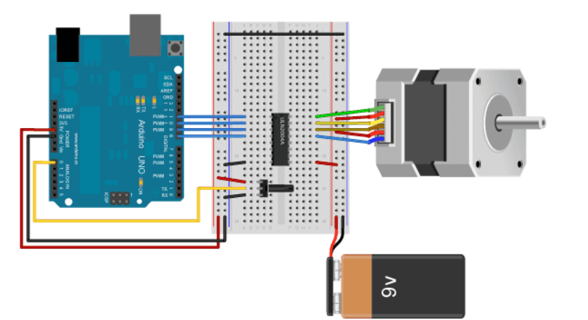

Slide 29
GSM
The Arduino GSM shield allows an Arduino board to connect to the internet, send and receive SMS, and make voice calls using the GSM library.
GSM
GPRS -obtain the Access Point Name (APN) username/password from the network operator , data rates between 56-114 kbit per second
GSM shield accepts cards in the mini-SIM format (25mm long and 15mm wide).

Slide 30
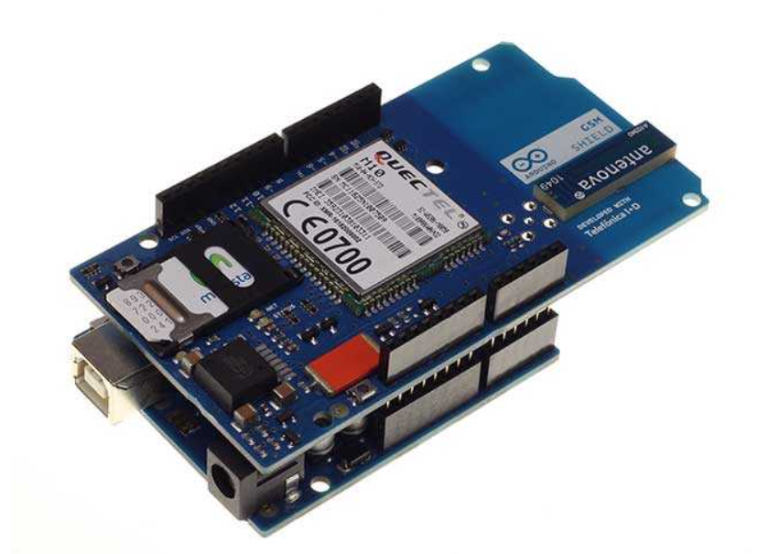

Slide 31
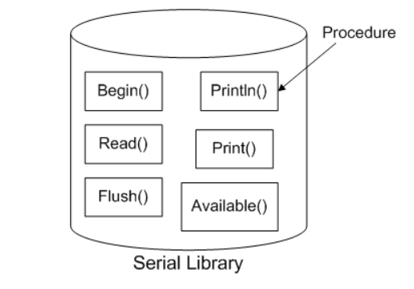
What is library ?
A library is a big collection of procedures, where all the procedures are related! If you, say, want to control a motor, you may want to find a Motor Control Library.
The library we will be using is the Serial Library, which allows the Arduino to send data back to the computer

Slide 32
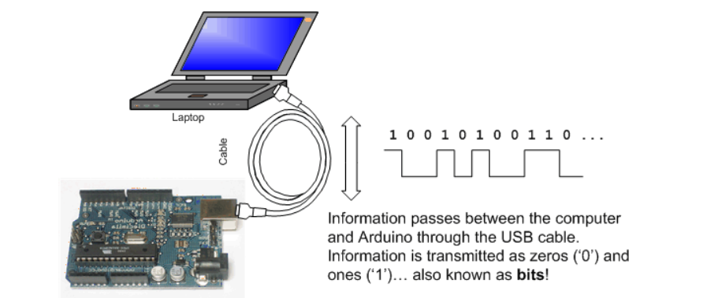
What is serial ?
The word serial means "one after the other."
Serial data transfer is when we transfer data one bit at a time, one right after the other.
Information is passed back & forth between the computer and Arduino by, essentially, setting a pin high or low.(Light)

Slide 33
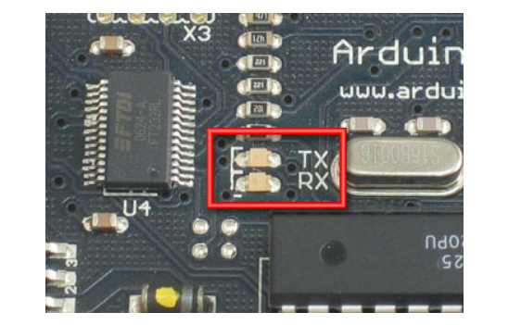
TX & Rx
We've actually used the Serial communications capability already quite a bit...that's how we send sketches to the Arduino! When you Compile/Verify what you're really doing is turning the sketch into binary data (ones and zeros). When you Upload it to the Arduino, the bits are shoved out one at a time through the USB cable to the Arduino where they are stored in the main chip.
upload a sketch, look carefully at the two LEDs near the USB connector, they'll blink when data is being transmitted. One blinks when the Arduino is receiving data (RX) and one blinks when the Arduino is transmitting data (TX)

Slide 34
Hello world !!
void setup()
{
Serial.begin(9600); // set up Serial library at 9600
Serial.println("Hello world!");
}
void loop()
{
}

Slide 35
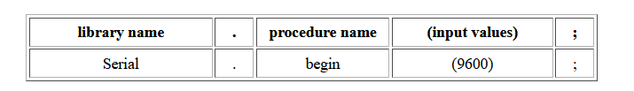
Conn…
The first line of code in the setup procedure is this one
Serial.begin(9600);
We definitely see that there is a Serial thing going on, and it looks like there is a procedure call as well. This is a library procedure call. The library is called Serial and inside the library is a procedure called begin.
If there's no library name, it means that the procedure is in the 'default' collection of procedures we use. For example, delay()

Slide 36
Conn…
It's the procedure that gets the Serial stuff ready. But what's the 9600 about?
9600 bps, and just so you know bps stands for bits-per-second.
Serial.begin sets up the Arduino with the transfer rate we want, in this case 9600 bits per second.
println which is just a shorthand for "print line".

Slide 37
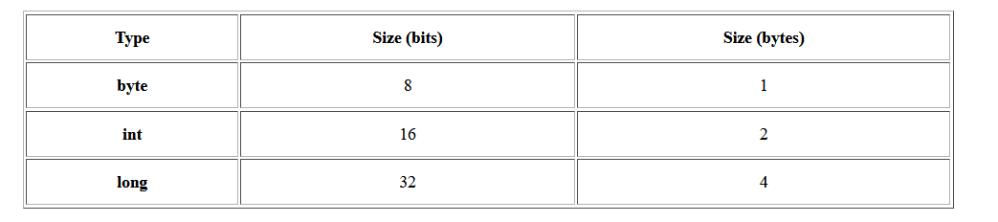
Conn…
void loop() // run over and over again
{
Serial.println("Hello world!"); // prints hello with ending line break
delay(1000);
}

Slide 38
Any Questions?

